Slide 1
Assessment Support (Quantitative)
Attendance Code:
Laura Perry (Academic Mentor in Health Sciences)

Slide 2
Outline of the session
Two parts:
Taught section: Go through the requirements of the assessment
Independent Work and 1-to-1 Support: Time to work on the assessment and receive 1-to-1 support from the AM.

Slide 3
Assessment Overview
Description: 750-word template on the critical appraisal of a research article using quantitative research methodology.
Weighting: 50%
Deadline: ​Friday 13th March 2026 at 3pm

Slide 4
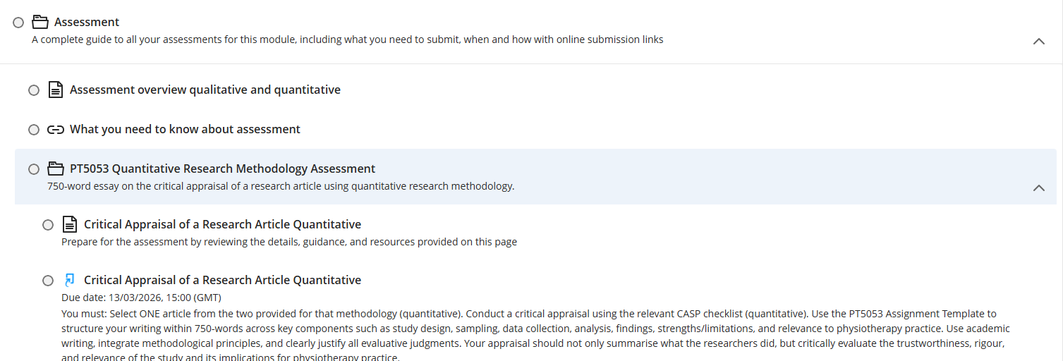
Assessment Information (Show on Weblearn)

Slide 5


Steps to completing the assessment
Step 1: Pick your article if you haven’t already (RCT 1 OR RCT2)
OR

Slide 6



Steps to completing the assessment
Step 2: Complete the CASP (for RCTs) for your chosen RCT (RCT 1 OR RCT2)

Slide 7
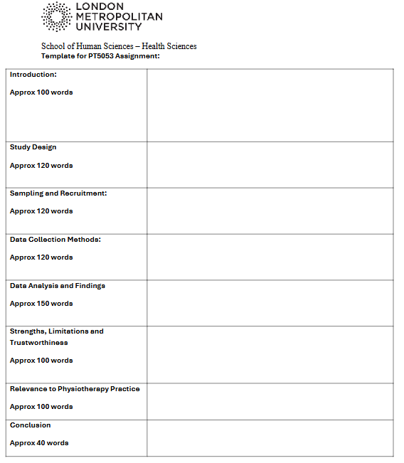
Steps to completing the assessment
Step 3: Download and complete the ‘Template STUDENT PT5053.docx’ based on your chosen RCT and the CASP you have completed.

Slide 8
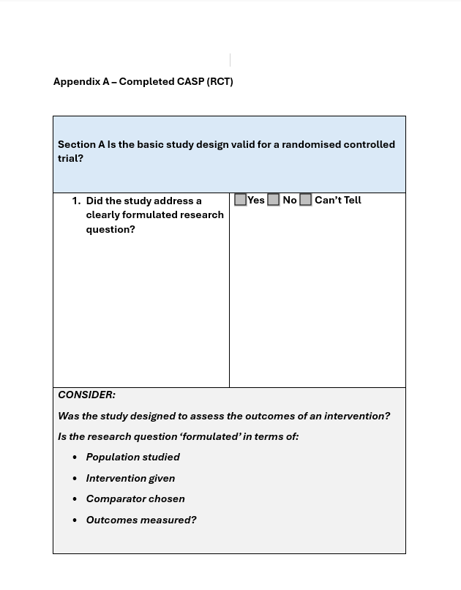
Steps to completing the assessment
Step 4: Add your completed CASP (RCT) as an appendix to your Template STUDENT PT5053.docx
Key Points for Appendices:
Appendices should appear after the reference list.
Appendices should be referred to within the main text (e.g., ‘See Appendix A for the completed CASP RCT’)
Each appendix should be labelled with a letter in alphabetical order (Appendix A, Appendix B, etc.).
Each appendix should have a clear title describing its contents.

Slide 9
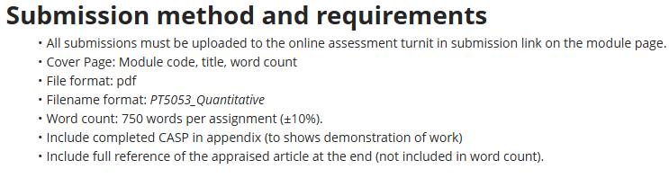
Steps to completing the assessment
Step 5: Ensure you adhere to the submission method and requirements:

Slide 10


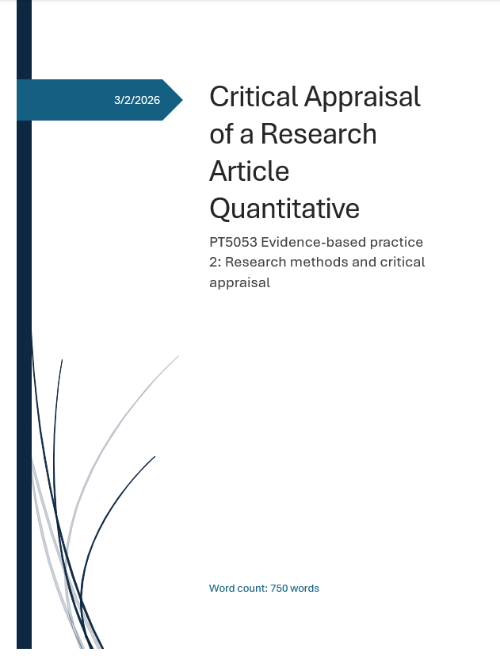
Title Page/Cover Sheet etc.
In Word, Click Insert → cover page and pick one.

Slide 11
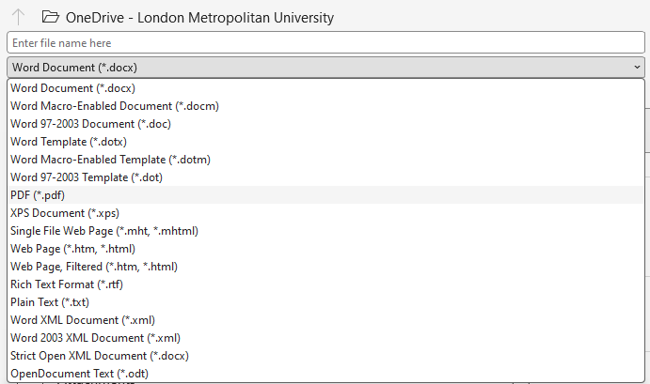
Saving as a PDF
File → Save as → Change the drop down from word to pdf
Filename format: PT5053_Quantitative

Slide 12
Word Count
To check the word count for your text, highlight the section you want to measure and refer to the number displayed at the bottom left of the Word document.
You must ensure that your work falls within the required word count of 750 words ±10% (i.e., 675–825 words).
Exceeding or falling short of this range will have negative consequences for your marks.

Slide 13
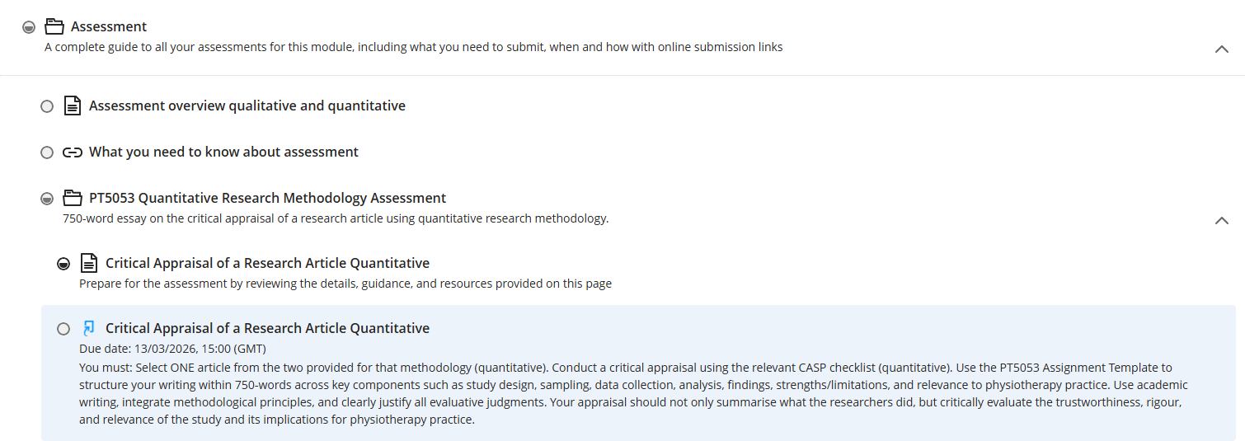
Steps to completing the assessment
Step 6: Submit before the deadline (Friday 13th March 2026 at 3pm)
Do NOT leave it until the last minute to submit

Slide 14
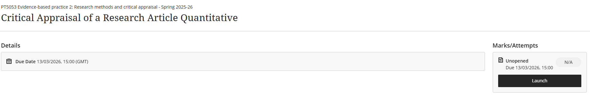
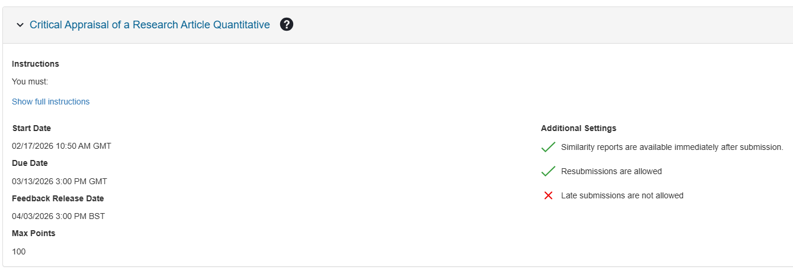
Steps to submitting the assessment (Show on Weblearn)

Slide 15
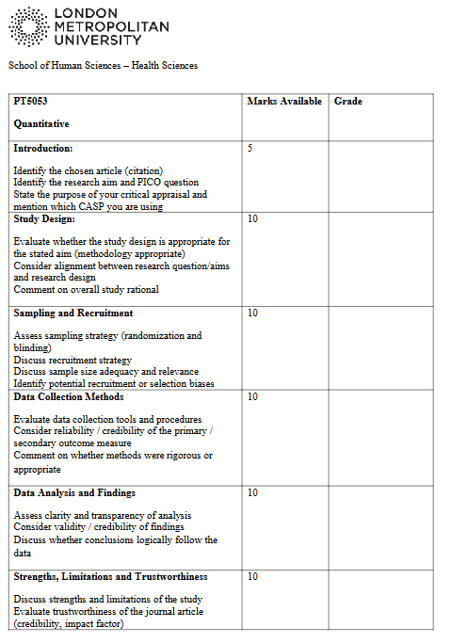
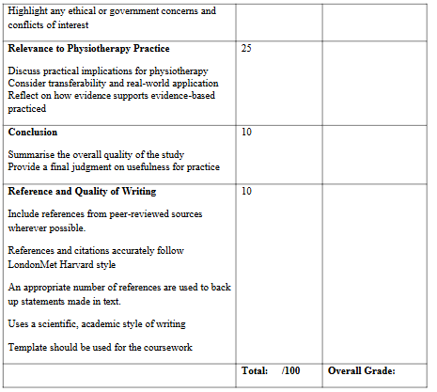
Marking Scheme (show on Weblearn)
Task – Download/open the template to complete/improve/take notes
Notes:
***Use the marking scheme as a checklist to ensure you have included everything ***

Slide 16
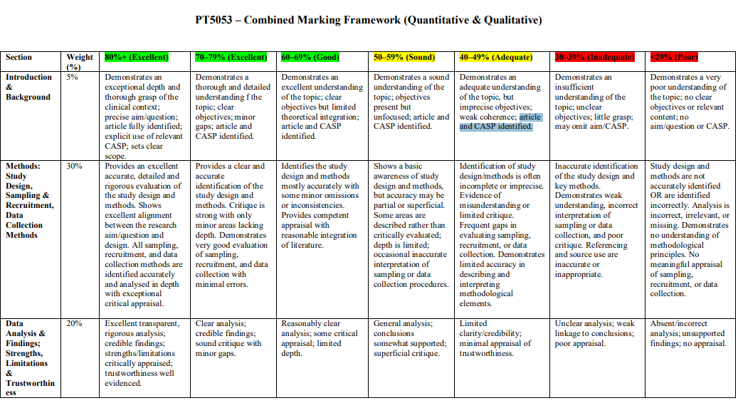
Marking Rubric (Show on Weblearn)

Slide 17
AI Declaration (Show on Weblearn)
Appropriate and inappropriate use are detailed on Weblearn

Slide 18
Final Tips
Be critical, not descriptive
Be concise
Ensure all content is placed in the correct section of the template.

Slide 19
Any Questions on Part 1?
Deadline: Friday 13th March 2026 at 3pm

Slide 20

Break (10-15 minutes)

Slide 21
Part 2: Independent Work and 1-to-1 Support

Slide 22
Reminder: Drop In Session
I will be running a drop‑in session on:
📅 Thursday 5th March
⏰ 11:00–13:00
📍 T11‑06
This is another opportunity to get support with your first assessment. Please bring any drafts or questions you have.
The drop‑in will operate on a first‑come, first‑served basis. Attendance at the drop-in session is optional.

